Slide 1
Web Survey System
Drop Table team;

Slide 2



Project Definition
Web-based survey system
Can be implemented on any website
Customizable questions and email script
Generates insightful reports from responses

Slide 3
What makes it unique?
Semantic Differential Questions (w/ Likert Scale)
Survey Structure Targets Companies of Any Size
Left Statement (Positive) |  |  |  | Right Statement (Negative)
 | Strongly Agree | Mostly Agree | Partly Agree | Partly Agree | Mostly Agree | Strongly Agree
CSC 490 is great! | • | ◦ | ◦ | ◦ | ◦ | ◦ | CSC 490 is awful!
 | 1 ➡ ∞ |  | 1 ➡ ∞ |  | 1 ➡ ∞
Company |  | Survey |  | Department |  | Participant

Slide 4

Project Requirements
Administrative
Administrator must log in to access admin page.
Administrator should be able to manage (create, update, delete):
Companies
Surveys
Departments
Participants
Questions

Slide 5
Project Requirements
Administrative
Administrator should create new surveys with the below process:
Create a company record or choose an existing one.
Create a list of departments involved in the survey.
Supply a comma delimited list of emails for each department.
Choose the questions involved in the survey.
Automatic emails should be sent out to each survey participant.
Administrator should be able to send out reminder emails to:
All participants in the company who have not completed the survey.
All participants in a department who have not completed the survey.
An individual participant who has no completed the survey.
Administrator should be able to generate Excel reports.
Overall survey results and breakdown by department.

Slide 6

Project Requirements
Survey
Participant should receive email with link to survey page.
Hyperlink should contain a unique ID.
Survey page should not be accessible with an invalid ID.
Survey questions should be semantic differential.
Response choices should be Likert scale.
Participant must complete all questions before submitting.
The participant should be prompted for confirmation.
If any questions remain incomplete, the earliest incomplete question should be shown (scroll to location).
Participant should only be able to submit the survey once.
Survey page should be inaccessibly with the same ID.
Responses should be recorded anonymously.

Slide 7

Project Requirements
Database
The database should be implemented using MySQL
Relational database
Free and open-source
The schema should be efficiently designed
Relationships used to eliminate redundant data
Appropriate data types and length restrictions.

Slide 8
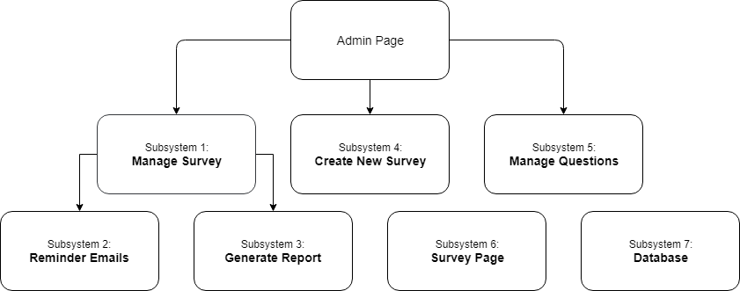
Subsystems

Slide 9
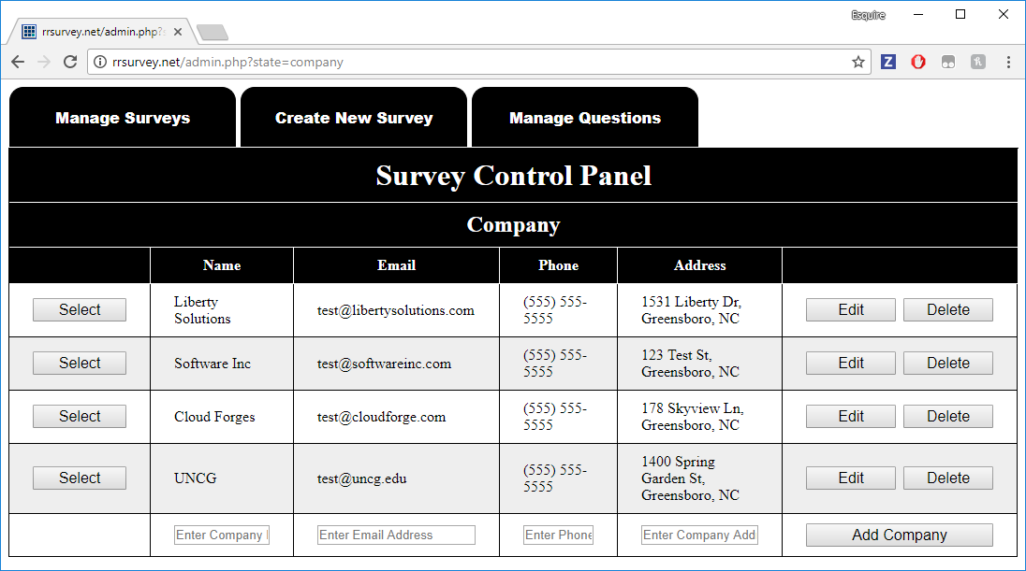
Subsystem 1: Manage Survey

Slide 10
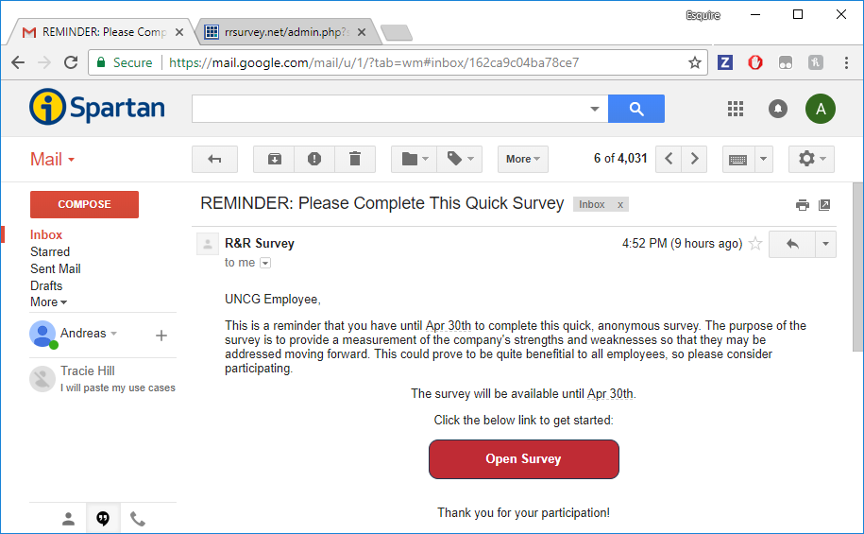
Subsystem 2: Reminder Emails

Slide 11
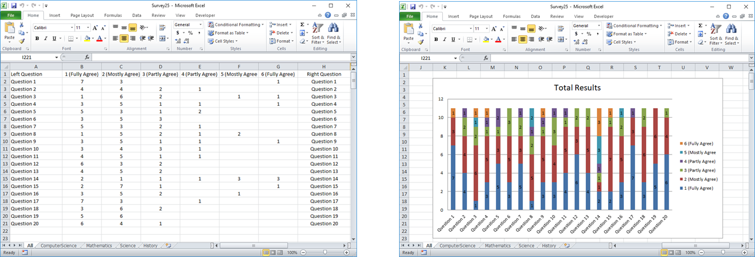
Subsystem 3: Generate Report

Slide 12
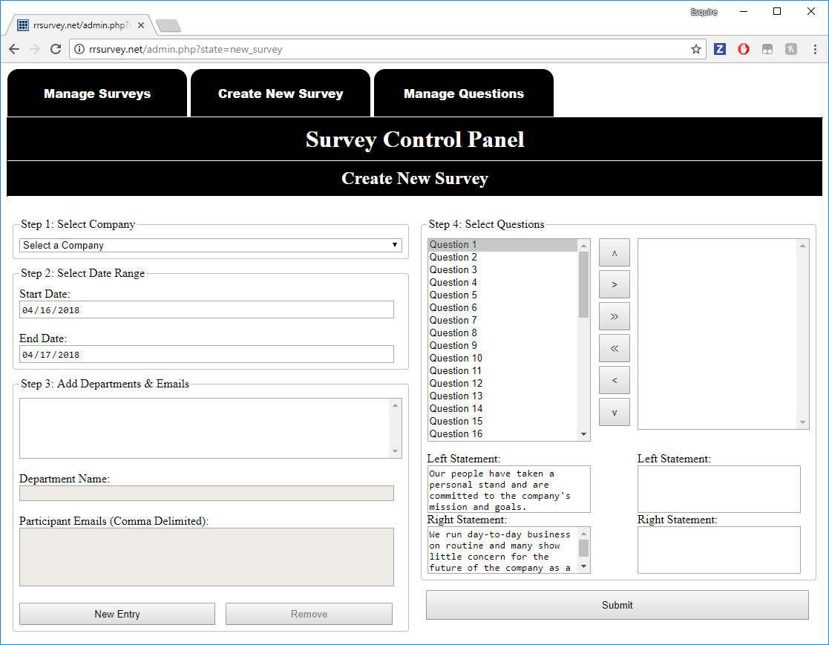
Subsystem 4: Create Survey

Slide 13
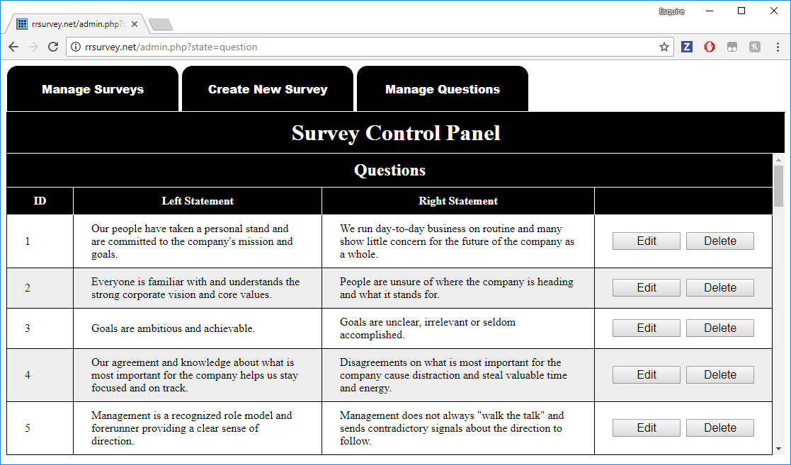
Subsystem 5: Manage Questions

Slide 14
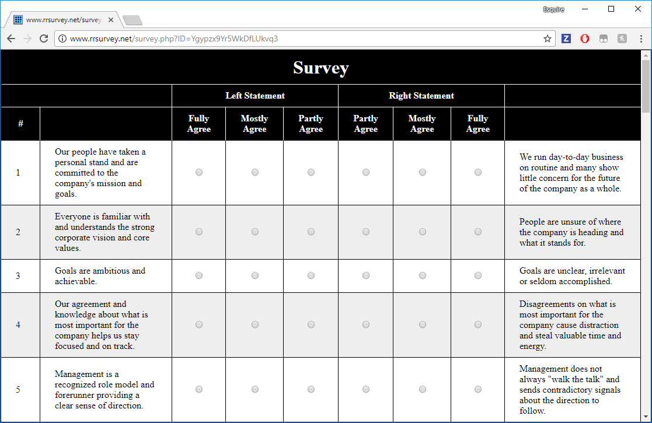
Subsystem 6: Survey Page

Slide 15
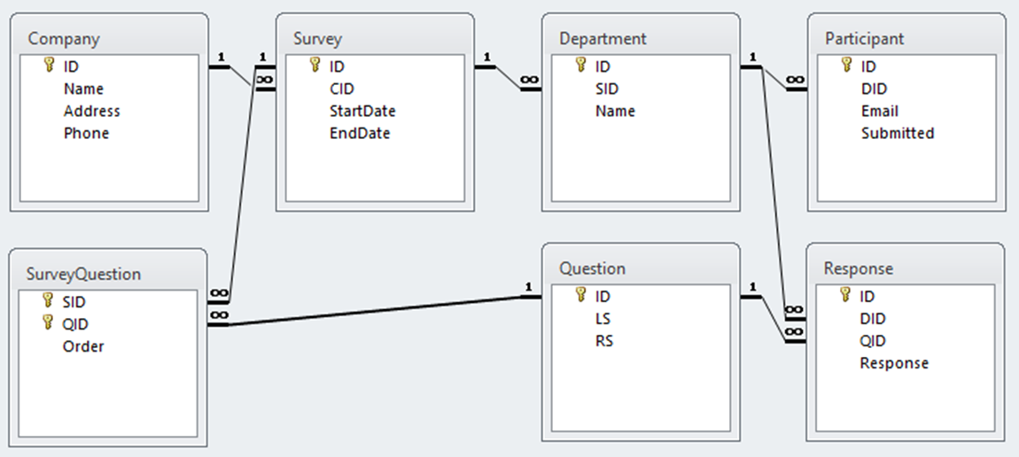
Subsystem 7: Database

Slide 16
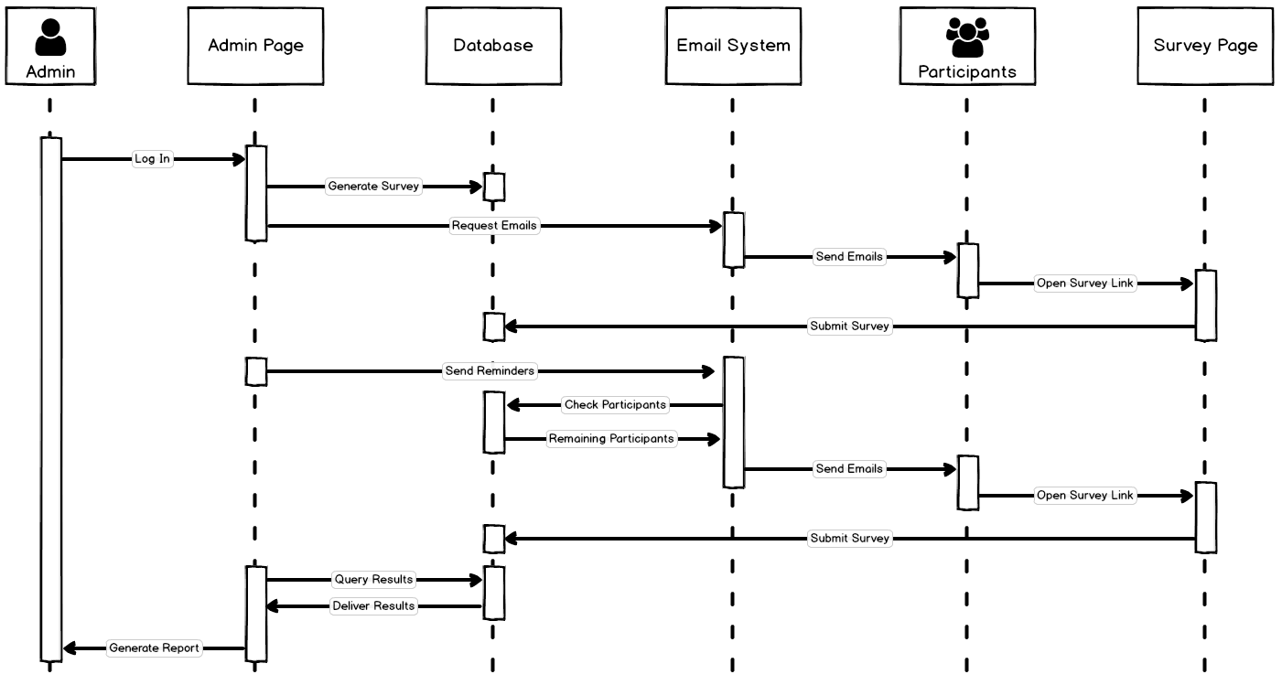
System Model Sequence Diagram

Slide 17
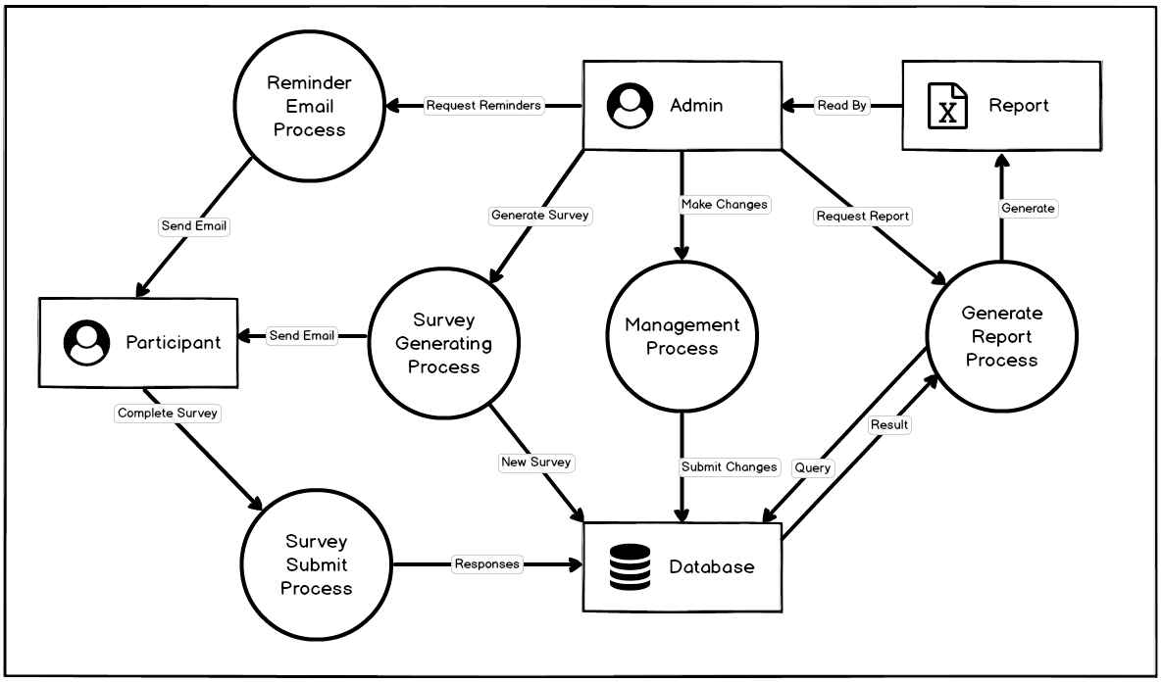
System Model Data Flow Diagram

Slide 18
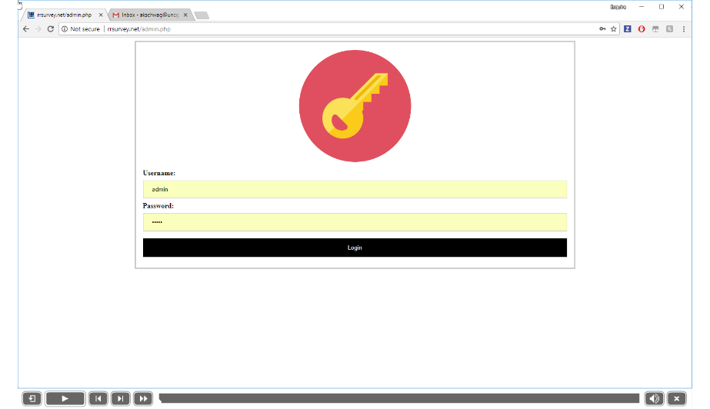
Software Demonstration

Slide 19


Future Plans
Implement Bootstrap library
Design a more elegant UI
Improve the ‘Submitted’ views
Current view is a bit plain
Test the system with a client
Riber Gustafson

